Slide 1
Hate Speech Detection In Twitter Using Deep Learning
Project by:
Amruth Kannan

Slide 2
Layout of the Presentation
Motivation
Objective
Base Paper
Problem Statement
Literature Survey
Modules
Dataset
Work Plan
Proposed Techniques
References

Slide 3
Motivation
Hate Speech has been growing rapidly in recent times.
Owing to hate speech may result in unwanted crimes.
It is essential to monitor the user’s posts and detect the hate speech.
Manually filtering any information from such a huge incoming traffic is
almost impossible .
So, the main aim is to filter the speeches using deep learning techniques.

Slide 4
Objective
An approach to filter the hate speech texts before it is spread.
To detect hate speech with higher accuracy using deep learning techniques.
To select suitable deep learning algorithms.
To compare the baselined models with the proposed models.
To develop a model yielding higher accuracy.

Slide 5
Specifications
SOFTWARE SPECIFICATION
Operating Systems: Windows 11
Back End: Python 3.10
HARDWARE SPECIFICATION
Processor: Intel Core
RAM: 8GB
Hard drive: 1TB

Slide 6
Base Paper
P. K. Roy, A. K. Tripathy, T. K. Das and X. -Z. Gao, "A Framework for Hate Speech Detection Using Deep Convolutional Neural Network," in IEEE Access, vol. 8, pp. 204951-204962, 2020, (SCI-E)

Slide 7
Problem Statement
The aim of this project is to identify the maximum number of Hate Speech (HS) related tweets from Twitter as soon as it is posted by users.
This issue falls within the context of a binary classification problem where tweets are classified into two classes, i.e. either Hate Speech (HS) or Non-Hate Speech (NHS).
The required features for baseline models was extracted using tf-idf techniques.
The proposed DCNN model has extracted the essential features from the tweet text using the convolution process with the help of multiple filters present in intermediate layers.

Slide 8
Literature Survey
Year | AUTHOR | TITLE | ALGORITHM | ACCURACY
2020 | Pradeep Kumar Roy et al, | A Framework for Hate Speech Detection Using Deep Convolutional Neural Network | D-CNN | 88%
 |  |  | LSTM | 53%
 |  |  | C-LSTM | 43%
2020 | O . Oriola et al[3], | Evaluating Machine Learning Techniques for Detecting Offensive and Hate Speech in South African Tweets | Random Forest | 88.7%
 |  |  | SVM | 85.8%
 |  |  | Gradient Boosting | 67%

Slide 9
Literature Survey
2019 | J . Wang et al,[34] | Large-Scale Text Classification Using Scope-Based Convolutional Neural Network: A Deep Learning Approach | LSS-CNN | 94.9%
 |  |  | LSTM | 91.2%
2019 | J. Zheng et al,[20] | A Hybrid Bidirectional Recurrent Convolutional Neural Network Attention-Based Model for Text Classification | Naive Bayes | 86.3%
 |  |  | CNN-word | 95.61%
 |  |  | RNN | 94.9%

Slide 10
Modules
MODULE 1 : DATA PROCESSING
Removing Special characters
Removing Stopwords
Tokenization
MODULE 2 : CLASSIFICATION ALGORITHMS
D-CNN
LSTM
MODULE 3: ESTIMATION OF ACCURACY
Precision
Recall
F1 - score

Slide 11
Data Set
The dataset used for this study is taken from Kaggle.com.
It is prepared by collecting the tweets from Twitter.
It is found that the dataset contained only English tweets by manual inspection.
The developed dataset contained a total of 31,962 English written tweets.
The dataset consists of 3 attributes and 31962 instances.
The attributes are id, label, tweets.
The most important attribute is tweets.

Slide 12
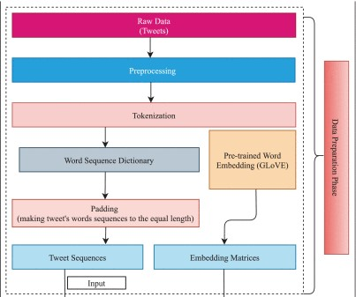
Proposed Techniques
D-CNN

Slide 13
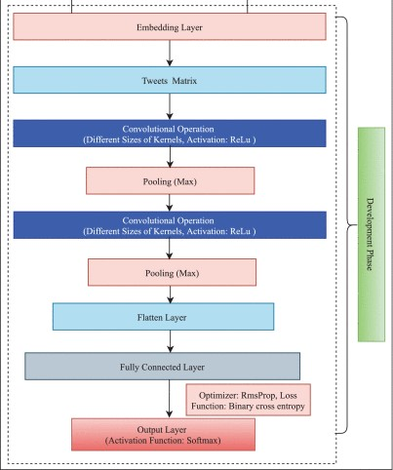

Slide 14
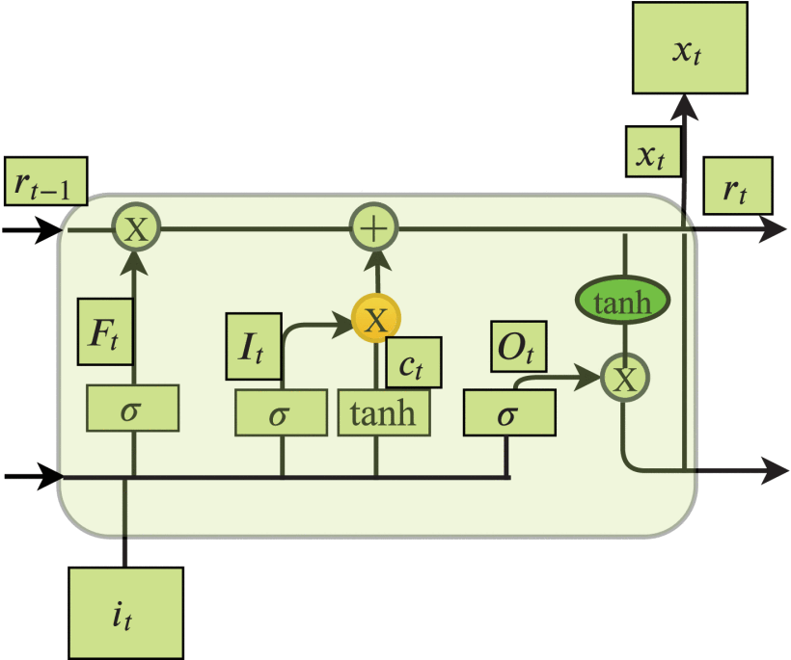
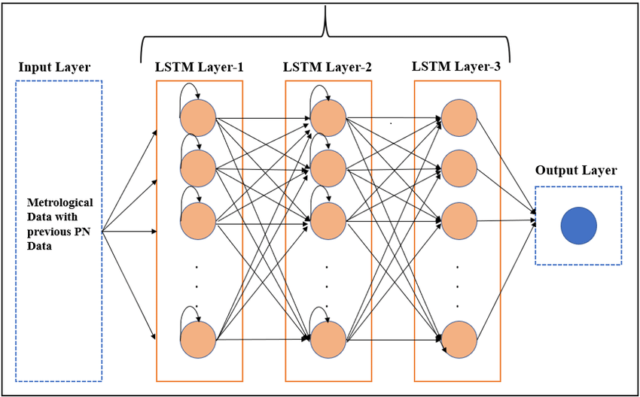
LSTM

Slide 15
DCNN:
D-CNNs use dynamic filters that are learned during the training process, as
opposed to static filters in traditional CNNs.
D-CNN architecture includes convolutional layers with dynamic filters,
along with other layers such as pooling and fully connected layers.
D-CNNs are particularly useful in tasks where the input data has varying
spatial characteristics, such as object detection in images or video frames.
LSTM:
Long Short-Term Memory (LSTM) neural networks are used in the fields of
deep learning and artificial intelligence.
Because the LSTM can develop itself through feedback connections
And it has a distinct advantage over traditional feed forward neural
networks.

Slide 16
Source Code: Reading Dataset
train_df = pd.read_csv("../content/train_E6oV3lV.csv") #to read and store in panda dataframe
test_df = pd.read_csv("../content/test_tweets_anuFYb8.csv") #to read and store in panda dataframe

Slide 17
Source Code: Data Processing
def process_message(review_text):
# remove all the special characters
new_review_text = re.sub("[^a-zA-Z]", " ",review_text)
# convert all letters to lower case
words = new_review_text.lower().split()
# remove stop words
words = [w for w in words if not w in eng_stops]
# lemmatizer
words = [lemmatizer.lemmatize(word) for word in words]
# join all words back to text
return (" ".join(words))
train_df['clean_tweet']=train_df['tweet'].apply(lambda x: process_message(x))
test_df['clean_tweet']=test_df['tweet'].apply(lambda x: process_message(x))

Slide 18
def createPieChartFor(t_df):
Lst = 100*t_df.value_counts()/len(t_df)
labels = t_df.value_counts().index.values
sizes = Lst
fig1, ax1 = plt.subplots()
ax1.pie(sizes, labels=labels, autopct='%1.2f%%', shadow=False, startangle=90)
ax1.axis('equal')
plt.show()
createPieChartFor(train_df.label)

Slide 19
def createWrdCloudForSentiment(sentiment):
sentiment_num = 1 if sentiment== 'Hate' else 0
temp_df = train_df[train_df.label==sentiment_num]
words = " ".join(temp_df.clean_tweet)
cleaned_words = " ".join([w for w in words.split()
if 'http' not in w
and not w.startswith('@')
and w!='user'
and w!='RT'])
wrdcld = WordCloud(stopwords=STOPWORDS,
background_color='black',
width=1500,
height=1000).generate(cleaned_words)
plt.figure(figsize=(10,10))
plt.imshow(wrdcld)
plt.axis('off')
plt.show

Slide 20
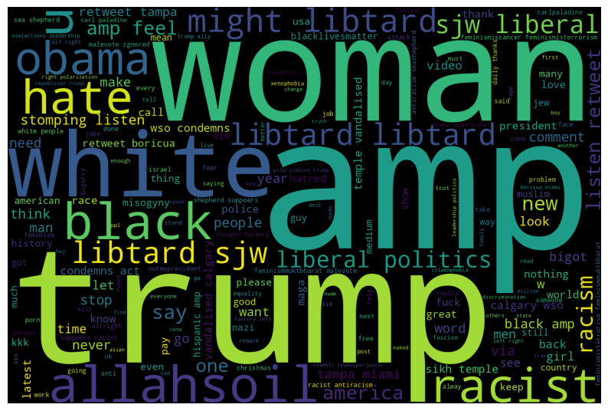
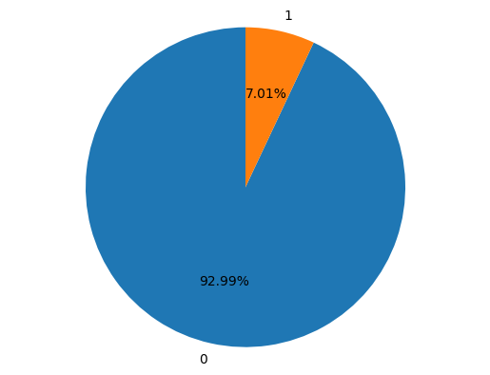
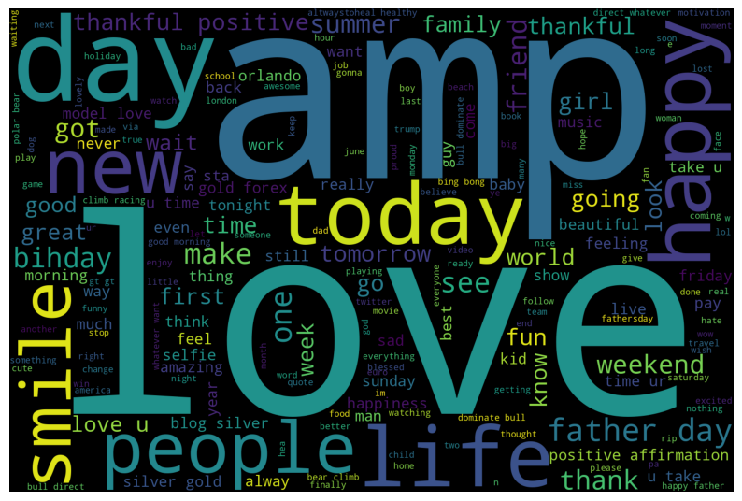

Slide 21
train_text=train_df.clean_tweet.values
test_text=test_df.clean_tweet.values
target=train_df.label.values
y=to_categorical(target)
print(train_text.shape,target.shape,y.shape)
train_text
y
target
X_train_text,X_val_text,y_train,y_val=train_test_split(train_text,y,test_size=0.2,stratify=y,random_state=123)
print(X_train_text.shape,y_train.shape)
print(X_val_text.shape,y_val.shape)
all_words=' '.join(X_train_text)
all_words=word_tokenize(all_words)
dist=FreqDist(all_words)
num_unique_word=len(dist)
num_unique_word
MAX_REVIEW_LEN=0
for text in X_train_text:
word=word_tokenize(text)
l=len(word)
MAX_REVIEW_LEN = max(MAX_REVIEW_LEN, l)
MAX_REVIEW_LEN

Slide 22
max_features = num_unique_word # find total number of unique words using word_tokenize
max_words = MAX_REVIEW_LEN # find maximum length of words using word_tokenize
batch_size = 50
epochs = 50
num_classes=2
tokenizer = Tokenizer(num_words=max_features)
tokenizer.fit_on_texts(list(X_train_text))
X_train = tokenizer.texts_to_sequences(X_train_text)
X_val = tokenizer.texts_to_sequences(X_val_text)
X_test = tokenizer.texts_to_sequences(test_text)
X_train = sequence.pad_sequences(X_train, maxlen=max_words)
X_val = sequence.pad_sequences(X_val, maxlen=max_words)
X_test = sequence.pad_sequences(X_test, maxlen=max_words)
print(X_train.shape,X_val.shape,X_test.shape)

Slide 23
Source Code : LSTM
def trainandplotmodel(model):
history=model.fit(X_train, y_train, validation_data=(X_val, y_val),epochs=epochs, batch_size=batch_size, verbose=1)
loss, accuracy = model.evaluate(X_train, y_train, verbose=False)
print("Training accuracy: {:.4f}".format(accuracy))
loss, accuracy = model.evaluate(X_val, y_val, verbose=False)
print("Testing accuracy: {:.4f}".format(accuracy))
plot_history(history)
model1=Sequential()
model1.add(Embedding(max_features,100,mask_zero=True))
model1.add(LSTM(16,dropout=0.4, recurrent_dropout=0.4,return_sequences=True))
model1.add(LSTM(8,dropout=0.5, recurrent_dropout=0.5,return_sequences=False))
model1.add(Dense(num_classes,activation='sigmoid'))
model1.compile(loss='binary_crossentropy',optimizer=Adam(lr=0.001),metrics=['accuracy'])
model1.summary()

Slide 24
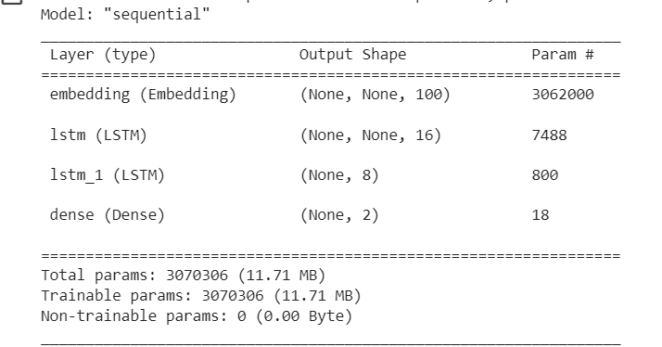

Slide 25
Source Code : Data Preprocessing
def message_to_token_list(s):
tokens = tokenizer.tokenize(s)
lowercased_tokens = [t.lower() for t in tokens]
lemmatized_tokens = [lemmatizer.lemmatize(t) for t in lowercased_tokens]
useful_tokens = [t for t in lemmatized_tokens if t in words]
return useful_tokens
def message_to_word_vectors(message, word_dict=words):
processed_list_of_tokens = message_to_token_list(message)
vectors = []
for token in processed_list_of_tokens:
if token not in word_dict:
continue
token_vector = word_dict[token]
vectors.append(token_vector)
return np.array(vectors, dtype=float)

Slide 26
Source Code: Embedding and Padding
def df_to_X_y(dff):
y = dff['label'].to_numpy().astype(int)
all_word_vector_sequences = []
for message in dff['tweet’]:
message_as_vector_seq = message_to_word_vectors(message)
if message_as_vector_seq.shape[0] == 0:
message_as_vector_seq = np.zeros(shape=(1, 100))
all_word_vector_sequences.append(message_as_vector_seq)
return all_word_vector_sequences, y
def newdf(message):
message_as_vector_seq = message_to_word_vectors(message)
if message_as_vector_seq.shape[0] == 0:
message_as_vector_seq = np.zeros(shape=(1, 100))
return message_as_vector_seq

Slide 27
def pad_X(X, desired_sequence_length=57):
X_copy = deepcopy(X)
for i, x in enumerate(X):
x_seq_len = x.shape[0]
if(x_seq_len<desired_sequence_length):
sequence_length_difference = desired_sequence_length - x_seq_len
pad = np.zeros(shape=(sequence_length_difference, 100))
X_copy[i] = np.concatenate([x, pad])
return np.array(X_copy).astype(float)
def newpad(message, desired_sequence_length=57):
x_seq_len=message.shape[0]
if(x_seq_len<desired_sequence_length):
sequence_length_difference = desired_sequence_length - x_seq_len
pad = np.zeros(shape=(sequence_length_difference, 100))
message = np.concatenate([message, pad])
return message

Slide 28
Source code: LSTM and CNN
def LSTM():
a=newdf(entry1.get())
b=newpad(a)
b = np.expand_dims(b, axis=0)
test_predictions = (best_model.predict(b) > 0.5).astype(int)
print(test_predictions)
def DCNN():
a=newdf(entry1.get())
b=newpad(a)
b = np.expand_dims(b, axis=0)
test_predictions = (best_model1.predict(b) > 0.5).astype(int)
print(test_predictions)

Slide 29
model1 = Sequential()
model1.add(layers.Input(shape=(57, 100)))
model1.add(Conv1D(64, 5, activation='relu'))
model1.add(MaxPooling1D())
model1.add(Flatten())
model1.add(Dense(64, activation='relu'))
model1.add(Dropout(0.5))
model1.add(Dense(64, activation='relu'))
model1.add(Dropout(0.5))
model1.add(Dense(1, activation='sigmoid’))
model = Sequential([])
model.add(layers.Input(shape=(57, 100)))
model.add(layers.LSTM(64, return_sequences=True))
model.add(layers.Dropout(0.2))
model.add(layers.LSTM(64, return_sequences=True))
model.add(layers.Dropout(0.2))
model.add(layers.Flatten())
model.add(layers.Dense(1, activation='sigmoid'))

Slide 30
Source code : GUI
customtkinter.set_appearance_mode("dark")
customtkinter.set_default_color_theme("blue")
root=customtkinter.CTk()
root.geometry("500x350")
frame=customtkinter.CTkFrame(master=root)
frame.pack(pady=20,padx=60,fill="both",expand=True)
label=customtkinter.CTkLabel(master=frame, text="Hate speech detection")
label.pack(pady=12, padx=10)
entry1 = customtkinter.CTkEntry(master=frame,placeholder_text= "Data Entry")
entry1.pack(pady=12, padx=10)
button1 = customtkinter.CTkButton(master=frame,text="LSTM",command = LSTM)
button1.pack(pady=12, padx=10)
button2 = customtkinter.CTkButton(master=frame,text="DCNN",command = DCNN)
button2.pack(pady=12,padx=10)
root.mainloop()

Slide 31
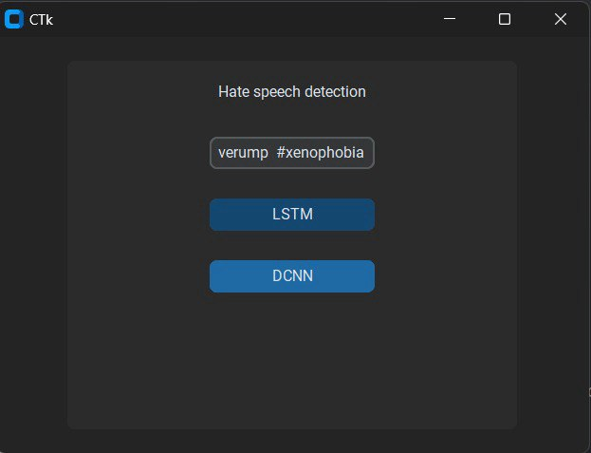
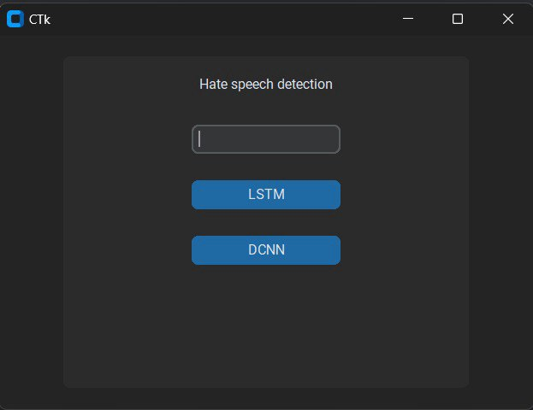
GUI

Slide 32
Conclusion
The objective of this project is to use deep learning techniques (D-CNN) for effective hate speech detection.
The proposed model uses multiple layers of convolution with different filter sizes to extract hidden contextual features from tweet text.
The accuracy outcomes of D-CNN and LSTM algorithms are analyzed and compared for hate speech detection.
It is found that D-CNN with k-fold has better accuracy than LSTM.

Slide 33
EXPECTED TIME PLAN:
Project paper discussion & Abstract Submission – 13-02-24
(12 Days)
Module 1 – 28-02-24
Module 2 – 05-03-24
Module 3 – 28-03-24
Testing & Implementation – 02-03-24

Slide 34
References
T. K. Das, D. P. Acharjya, and M. R. Patra, Opinion mining about a product by analyzing public tweets in Twitter, in Proc. Int. Conf. Comput. Commun. Informat., Jan. 2014, pp. 14.
P. Charitidis, S. Doropoulos, S. Vologiannidis, I. Papastergiou, and S. Karakeva, Towards countering hate speech against journalists on social media, Online Social Netw. Media, vol. 17, pp. 110, May 2020.
P. K. Roy, Multilayer convolutional neural network to lter low quality content from Quora, Neural Process. Lett., vol. 51, no. 1, pp. 805821, 2020.
H. M. Saleem, K. P Dillon, S. Benesch, and D. Ruths, A Web of hate: Tackling hateful speech in online social spaces, 2017, arXiv:1709.10159. [Online]. Available: http://arxiv.org/abs/1709.10159
C.Stokel-Walker, Alt-rights Twitter ishate-speechhub, NewScientist, vol. 237, no. 3167, p. 15, Mar. 2018.

Slide 35
THANK YOU

